Slide 1
Flight Price Prediction
Presentation By : OLIVER RAMAN | Internship 26

Slide 2
Agenda.
Overview.
Problem Statement.
Problem Understanding.
What is Flight Price Prediction?
Importance of Flight Price Prediction.
Exploratory data analysis.
Visualizations.
Analysis
Data cleaning steps.
Model Building.
Hyper Parameter Tuning.
Saving the model and making predictions.
Conclusion.

Slide 3
Overview.
In this particular presentation we will be looking on:
How to analyze the dataset of Flight Price Prediction.
What are the EDA steps in cleaning the dataset.
Overall analysis on the problem.
Model building from cleaned dataset.
Predicting Flight Price for saved best model.

Slide 4
Problem Statement.
Anyone who has booked a flight ticket knows how unexpectedly the prices vary. The cheapest available ticket on a given flight gets more and less expensive over time. This usually happens as an attempt to maximize revenue based on –
Time of purchase patterns (making sure last-minute purchases are expensive) .
Keeping the flight as full as they want it (raising prices on a flight which is filling up in order to reduce sales and hold back inventory for those expensive last-minute expensive purchases).
So, you have to work on a project where you collect data of flight fares with other features and work to make a model to predict fares of flights.

Slide 5
Problem Understanding.
Flight prices are something unpredictable. It’s more than likely that we spent hours on the internet researching flight deals, trying to figure an airfare pricing system that seems completely random every day.
Flight price appears to fluctuate without reason and longer flights aren’t always more expensive than shorter ones.
But now the question is how to know proper Flight price, for that we have built a Machine learning model which can predict the Flight price.
Using various features like Airline, Source, Destination, Arrival time, Departure time, Stops, Travelling date and the Price.

Slide 6
What is Flight Price Prediction?
Nowadays, the number of people travelling by flights have increased significantly. It is difficult for airlines to maintain prices, since prices change dynamically due to different conditions.
That’s why we will try to use machine learning to solve this problem.
This can help airlines by predicting what prices they can maintain. It can also help customers to predict future flight prices and plan their journey accordingly.

Slide 7
Importance of Flight Price Prediction.
Pricing in the airline industry is often compared to an intense game between carriers and passengers where each party pursues the best rates. Carriers love selling tickets at the highest price possible while still not losing consumers to competitors. Passengers are crazy about buying flights at the lowest cost available while not missing the chance to get on board.
All this makes flight prices fluctuant and hard to predict. But nothing is impossible for people armed with intellect and algorithms. Predicting flight prices helps an individuals to know and understand the future price of the flight tickets.

Slide 8
Importance of Flight Price Prediction.
There are two main use cases of flight price prediction in the travel industry.
OTAs and other travel platforms integrate this feature to attract more visitors looking for the best rates. Airlines employ the technology to forecast rates of competitors and adjust their pricing strategies accordingly.
A passenger-side predictor proposed by an OTA suggests the best time to buy a ticket so that travelers can make informed decisions. Carriers, on their end, try to find out the optimal price they should set to maximize revenue while remaining competitive.

Slide 9
Exploratory Data Analysis.

Slide 10
Firstly, I scraped the required data using selenium from makemytrip.com website.
And I have imported required libraries and I have imported the dataset which was in csv format.
Then I did all the statistical analysis like checking shape, nunique, value counts, info etc.
I have also dropped the Unnamed:o & Unnamed:o.1 column as I found it was the index column of csv file.
Next as a part of feature engineering I converted the data types of datetime columns and Price columns.
After that I saw many similar values which could be grouped together under a common name so I replaced all those values under a single heading.

Slide 11
While checking for null values I found no null values in the dataset.
I have extracted useful information from the raw dataset. Thinking that this data will help us more than raw data.
Then, I check the statistical description of our dataset.
Lastly, I checked for empty values present in our target column, and found no empty values.
Then, I proceeded with Data visualization for better understanding of the data.

Slide 12
Visualizations.
I have used count plots for the categorical features & bar plots to see the relation of categorical variables with the target.
And I have used 2 types of plots for numerical columns, one is dist plot for univariate and strip plot for bivariate analysis.
Univariate & Bivariate Analysis of different features in the dataset.

Slide 13
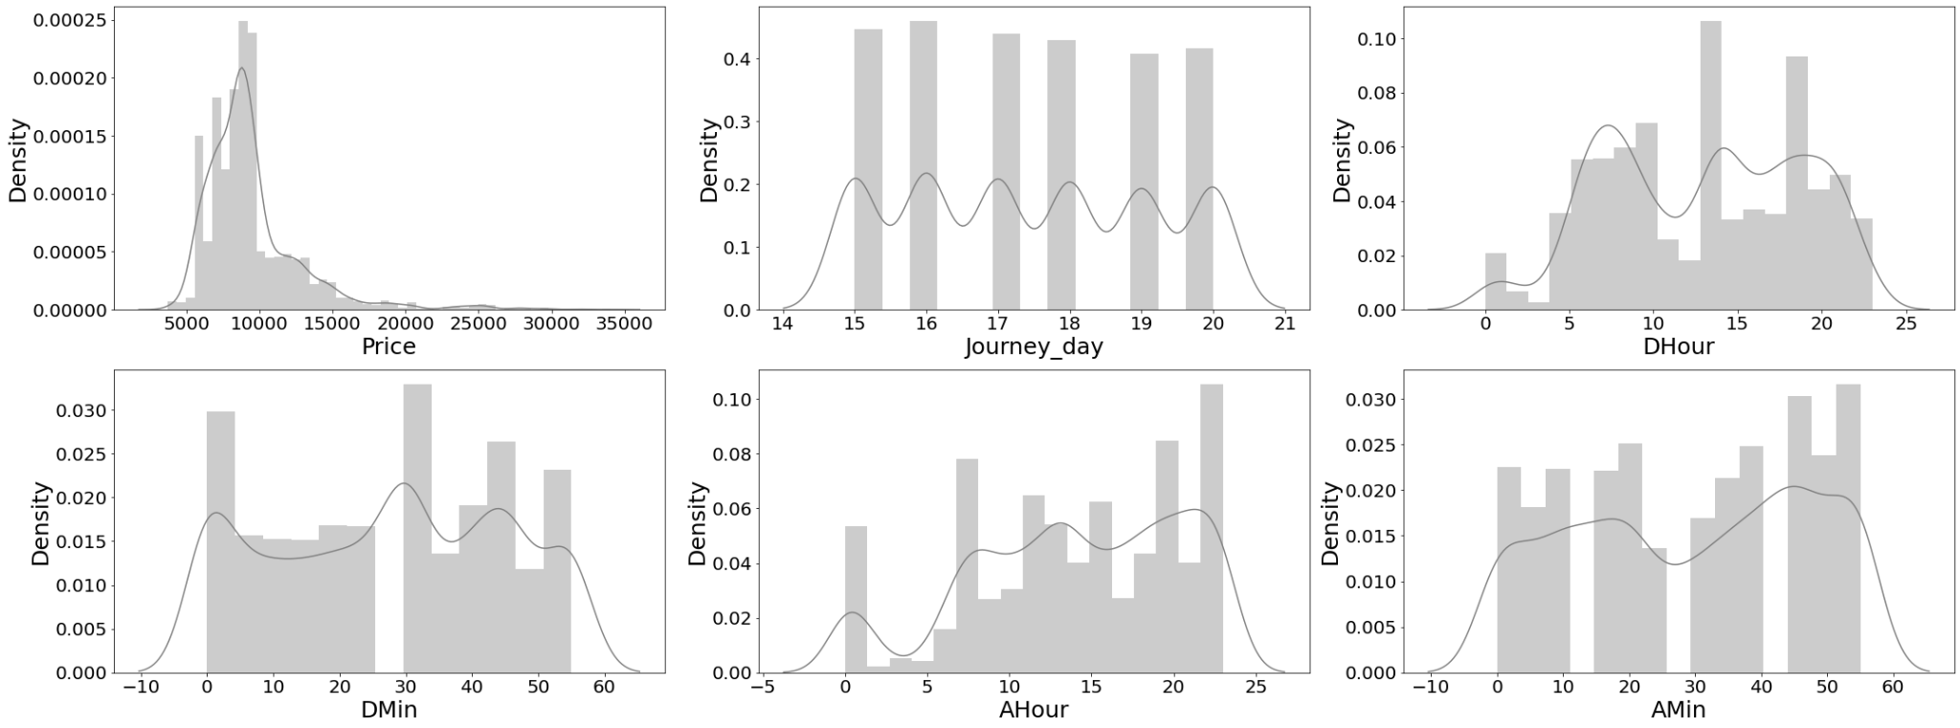
OBSERVATION: There is no skewness in any of the numerical columns.

Slide 14
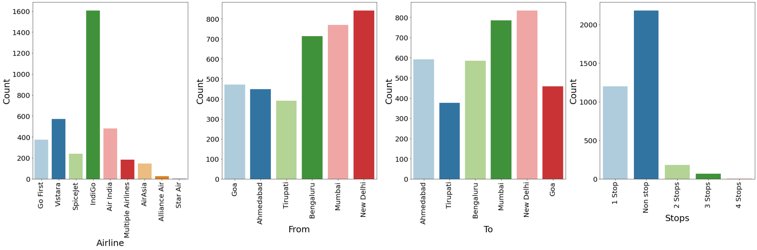
OBSERVATIONS:
Airline: Indigo has maximum count which means most of the passengers preferred Indigo for there travelling.
From: New Delhi has maximum count for source which means maximum passengers are choosing New Delhi as there source.

Slide 15
OBSERVATIONS:
To: New Delhi has maximum count for Destination which means maximum passengers are choosing New Delhi as there Destination.
Stops: Most of the flights have No stops in between and are direct flights. Secondly, most flights have 1 stop in between.

Slide 16
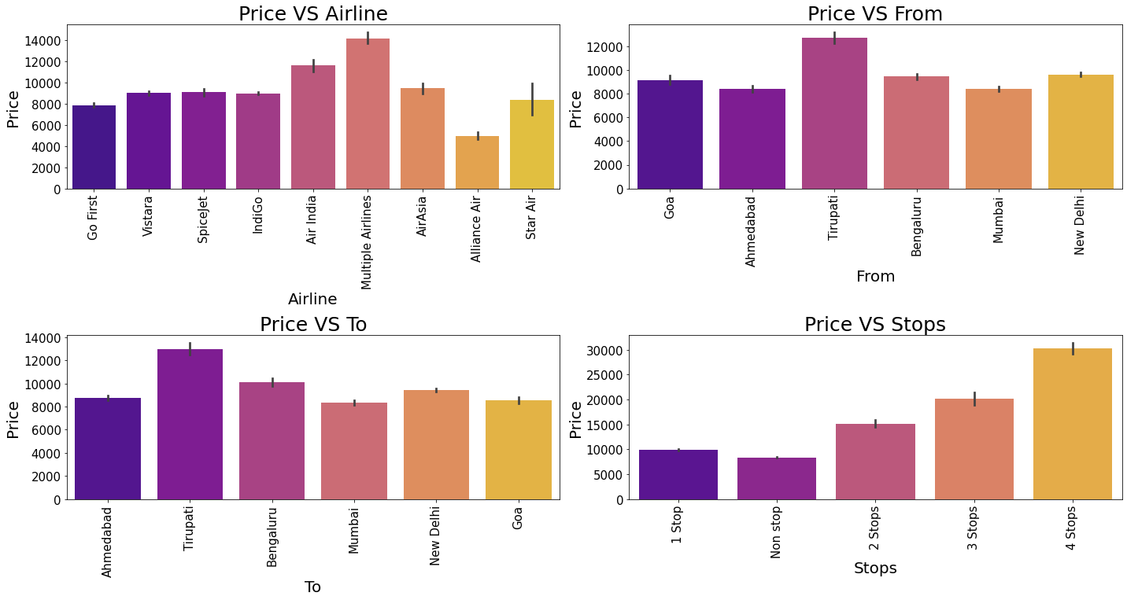
OBSERVATIONS:
Price vs Airline - For Multiple Airlines the Price is high compared to other Airlines.
Price vs From - Taking Tirupati as Source costs highest Price Compared to other Source points.

Slide 17
OBSERVATIONS:
Price vs To - Taking Tirupati as Destination costs highest Price Compared to other Destination points.
Price vs Stops - 4 stops or higher are costlier, compared to no stops & 1 stop.

Slide 18
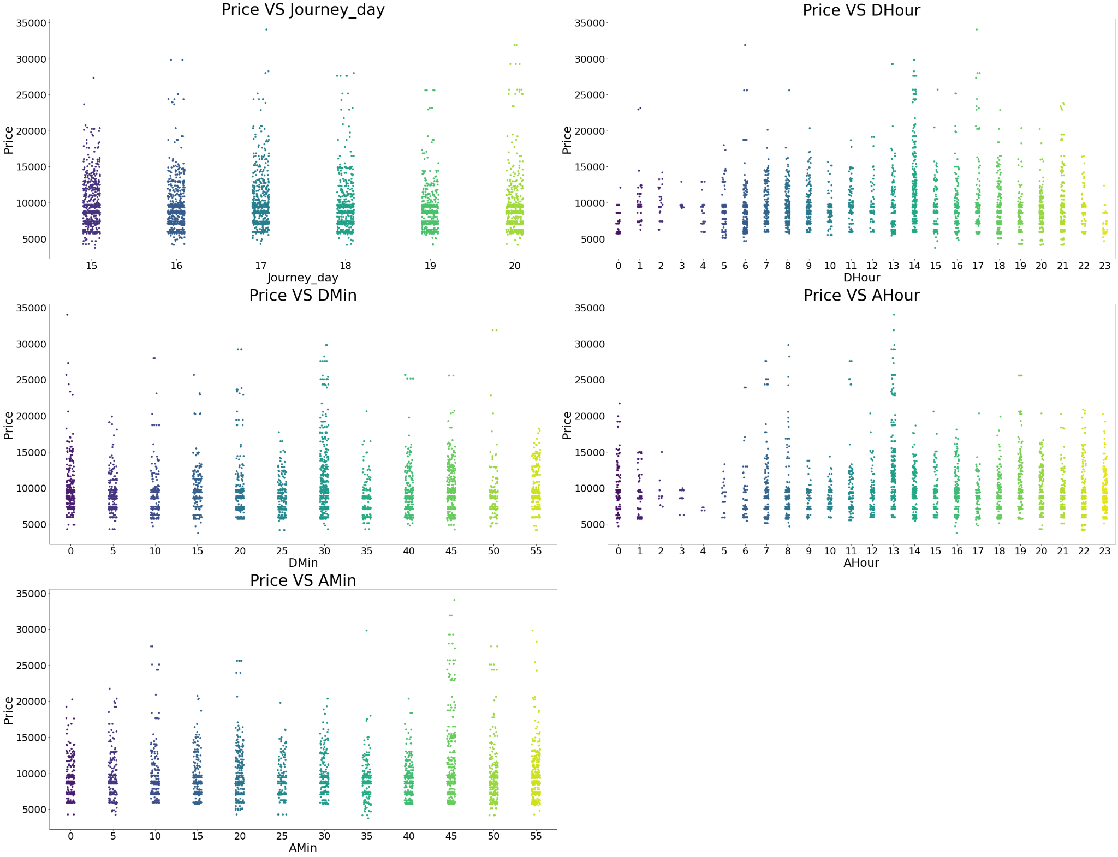
OBSERVATIONS:
Price vs Journey_day - In all the dates the price is almost same.
Price vs DHour - At 2PM departure time of every day the flight Prices are high so it looks good to book flights rather than this departure time.

Slide 19
OBSERVATIONS:
Price vs DMin - And Departure minute has less relation with target Price.
Price vs AHour - At 6AM, 7AM, 8AM, 11AM & 1PM Arrival time of every day the flight Prices are high so it looks good to book flights rather than this arrival time.

Slide 20
OBSERVATION: Price vs AMin - Arrival minute has less relation with target Price.

Slide 21
Analysis.
UNIVARIATE ANALYSIS :
I have used dist plot to check the skewness in numerical columns.
I have used count plot for each of the categorical columns, showing the count of the various features.
BIVARIATE ANALYSIS :
I have used bar plot for visualizing the relation between categorical columns and our target column, Price.
And also for continuous numerical variables I have used strip plot to show the relationship between numerical variables and target variable.

Slide 22
Data Cleaning Steps.
The data has been scrapped from makemytrip.com website using selenium, we had to clean it as per our convenience.
Some columns had incorrect data types which had to be changed to the right data type for visualization and model building.
Also, feature extraction was performed to extract useful features.
In the dataset, I found no null values, outliers and also no skewness.
Encoding of the categorical columns was done using Label Encoder.
Use of Pearson’s correlation coefficient was done to check the correlation between dependent and independent features.
Also standardization was conducted using Standard Scaler.
Lastly, followed by model building with all regression algorithms.

Slide 23
Model Building.
Since Price was my target and it was a continuous column so this particular problem was a regression problem. And I have used all regression algorithms to build my model.
By looking into the R2 scores, I found RandomForestRegressor as a best model with high R2 score & less error values.
Also to get the best model we have to run through multiple models and to avoid the confusion of overfitting we have to go through cross validation.

Slide 24
Regression Models.
regression

Slide 25
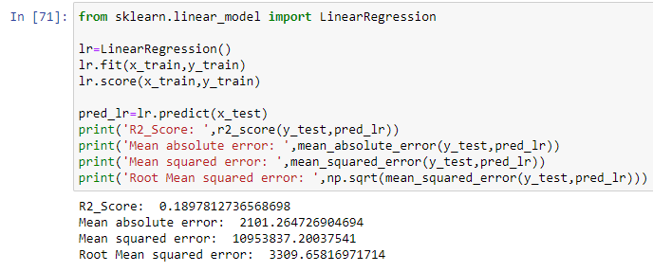
Linear Regression Model.
The Linear Regression model gave us an R2 Score of 18.97 %.

Slide 26
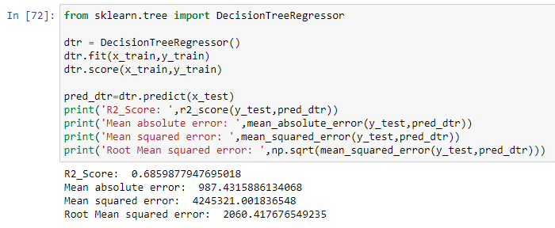
Decision Tree Regressor.
The Decision Tree Regressor model gave us an R2 Score of 68.59 %.

Slide 27
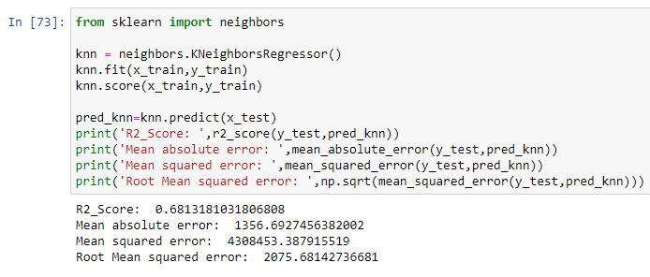
K-Nearest Neighbors Regressor.
The K-Nearest Neighbors Regressor model gave us an R2 Score of 68.13 %.

Slide 28
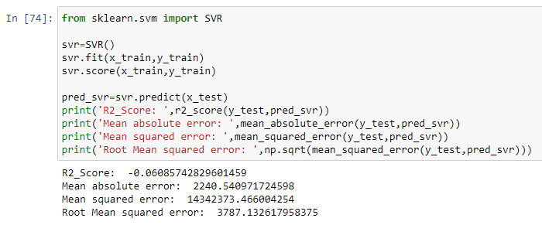
Support Vector Regressor (SVR).
The SVR model gave us an R2 Score of -6.08 %.

Slide 29
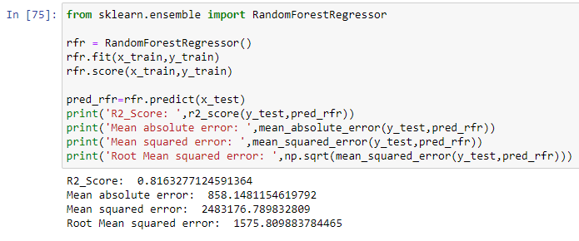
Random Forest Regressor.
The Random Forest Regressor model gave us an R2 Score of 81.63 %.

Slide 30
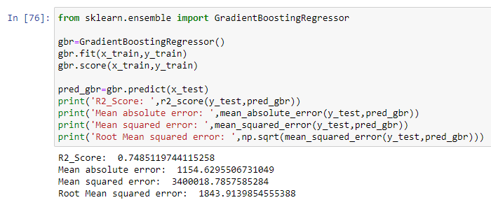
Gradient Boosting Regressor.
The Gradient Boosting Regressor model gave us an R2 Score of 74.85 %.

Slide 31
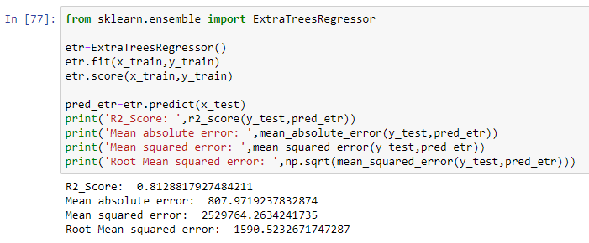
Extra Trees Regressor.
The Extra Trees Regressor model gave us an R2 Score of 81.28 %.

Slide 32
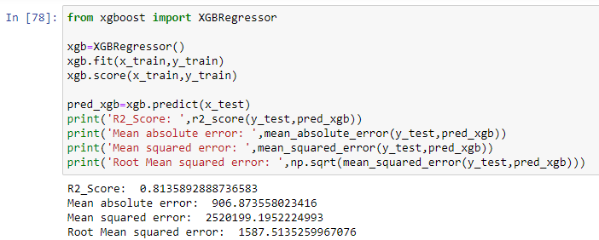
XGBoost Regressor.
The XGBoost Regressor model gave us an R2 Score of 81.28 %.

Slide 33
Analysis of Regression Models.
From the above regression models, the highest R2 score belongs to the Random Forest Regressor Model, followed closely by XGBoost Regressor Model & Extra Trees Regressor Model.
Next, the Gradient Boosting Regressor Model.
After that, the K-Nearest Neighbors Regression Model & Decision Tree Regressor Model.
Lastly, the Linear Regression Model.
Finally, the lowest score belongs to the SVR Model.

Slide 34
Hyper Parameter Tuning.
Since the R2 Score is the Highest and the RMSE score is the lowest in Random Forest Regressor Model, we shall consider it for hyper parameter tuning.
We shall use GridSearchCV for Hyper Parameter Tuning.

Slide 35
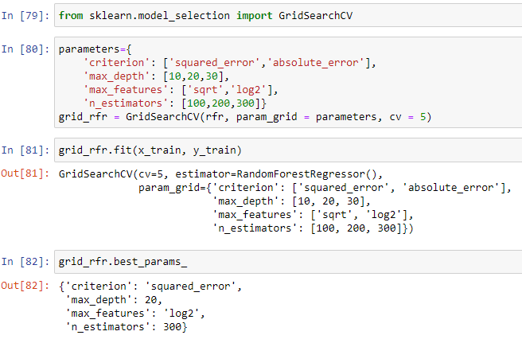
Hyper Parameter Tuning.

Slide 36
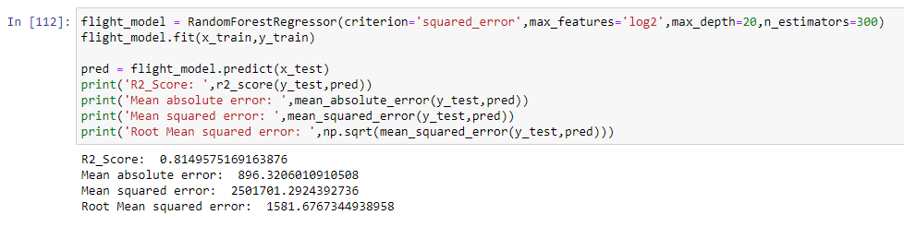
Hyper Parameter Tuning.
After Hyper Parameter Tuning, we have got a R2 score of 81.49 %.

Slide 37
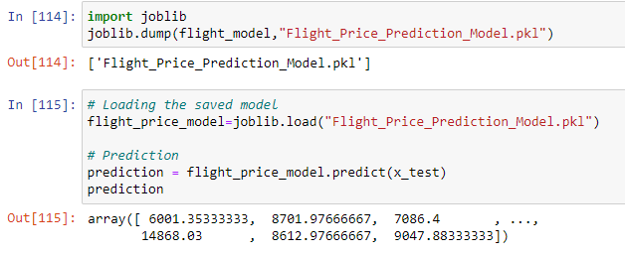
Saving the Best Model & Making Predictions.
Now we shall save the best model.

Slide 38
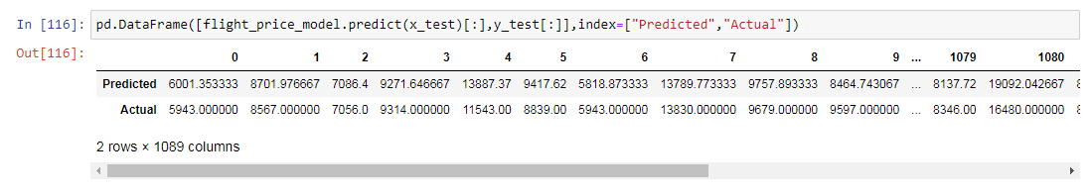
Saving the Best Model & Making Predictions.
Putting the predicted & actual values in a dataframe.

Slide 39
Conclusion.
In this project, we have used machine learning algorithms to predict the flight price.
We have mentioned the step by step procedure to analyze the dataset and finding the correlation between the features. Thus we can select the features which are correlated to each other and are independent in nature.
The power of visualization has helped us in understanding the data by graphical representation it helped me understand what data is trying to say.
Data cleaning is one of the most important steps to remove unrealistic values and unnecessary values.

Slide 40
Conclusion.
These feature sets were then given as an input to 8 algorithms and a hyper parameter tuning was done to the best model and the accuracy has been improved.
Thus, we calculated the performance of each model using different performance metrics and compared them based on those metrics. Then we have also saved the best model and predicted the flight price.
Then we have also saved the best model and predicted the flight price. It was good that the predicted and actual values were almost same.

